Slide 1


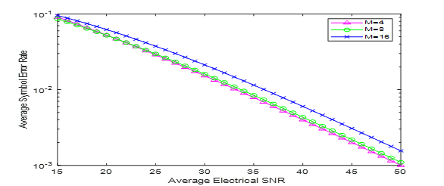
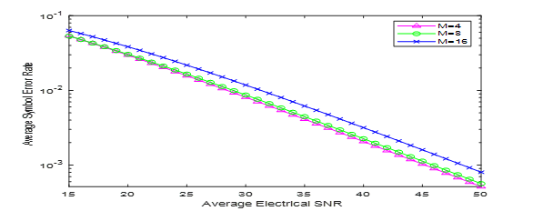
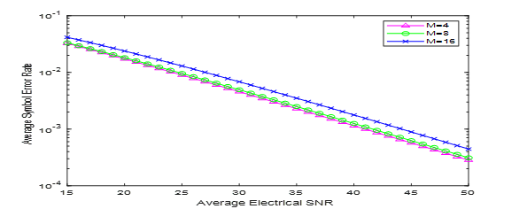
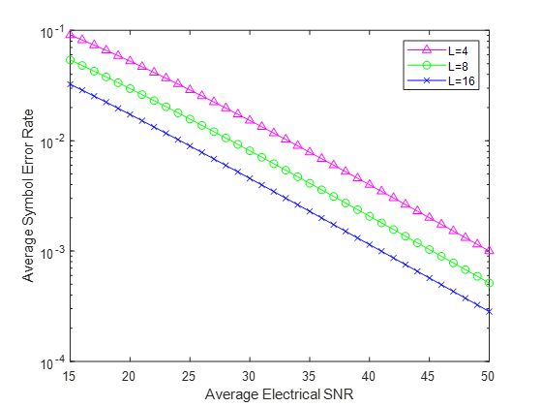
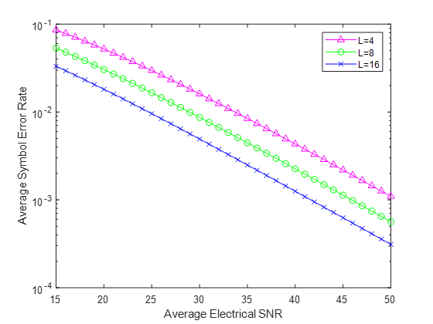
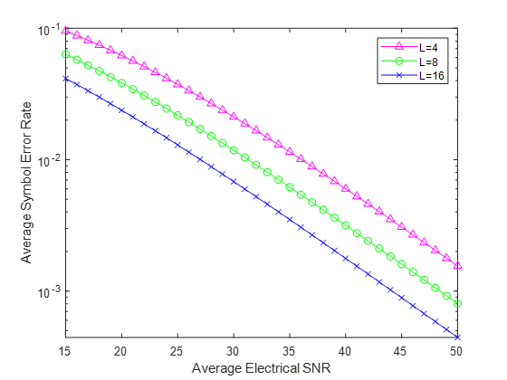



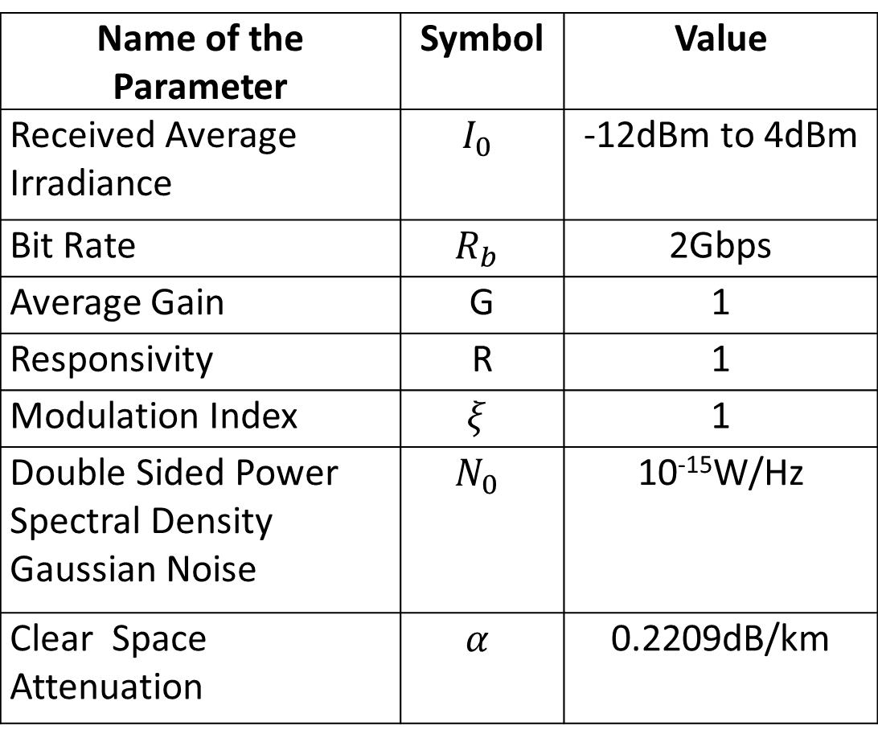

ksks
MIMO FSO COMMUNICATION USING HYBRID SUBCARRIER INTENSITY MODULATION OVER
DOUBLE GENERALISED GAMMA FADING
Jayesh kumar , Jaivardhan Sharma , Krishn Gopal Dwivedi , Honey Singh ,Piyush Jain
Department of Electronics & Communication Engineering,
Galgotias College of Engineering and Technology, Greater Noida
Abstract
Introduction
We have modelled the Free space Optical (FSO) communication channel using Double Generalized Gamma (GG) distribution under moderate turbulence condition.
We have used hybrid Subcarrier Intensity Modulation (SIM) with L-Pulse Position Modulation (LPPM) and M- ary Phase Shift Keying (MPSK).
We have also examined the Bit Error Rate (BER) of FSO system for average electrical SNR both for SISO and MIMO.
Results have shown that BER decreases for each value of M in MPSK with the increase in average length of PPM symbol .
In FSO,data is transferred data is transferred as a light source in the free space which provides higher data rate as compared to the optical fiber.
FSO offers easy installation, quick implementation of communication link, high band-width provisioning, and it can be used for both indoor and outdoor applications.FSO uses license free spectrum, which offers wireless connectivity at a low cost.
FSO wireless link is the weak link which introduces various impairments such as fading, scattering, atmospheric turbulence and absorption.
In previous works Log-normal distribution has been used more often but it is limited for weak turbulence conditions only.
Double Generalized Gamma (double GG) has also been proposed in some literatures. This model is applicable for all range of atmospheric turbulence conditions (from weak to strong)
Recent studies have shown that many mitigation techniques such as error correction coding, advanced modulation schemes and spatial diversity have been applied to improve weak link of FSO system.
In order to combat limitations of individual modulation techniques and to further improve BER performance of FSO system there has been use of Hybrid Modulation . Reported in previous work novel Hybrid PPM-BPSK-SIM has surpassed both PPM and BPSK-SIM modulation techniques.
another work performance of PPM-MSK-SIM is analyzed, it is shown that resulting hybrid technique combines the advantages of individual modulation scheme
In order to meet the rapid requirement of high data rate in beyond 5G system we proposed a hybrid modulation technique ie LPPM-MPSK-SIM to further improve the average SER of SISO & MIMO FSO system over double generalized gamma fading distribution.
System Model
In the transmitter section PPM encoder converts the block of data bits into PPM code words where M is the number of bits per PPM symbol and L is the average PPM symbol length.
The PPM code words are modulated by MPSK modulator on the optical signal intensity.
We then use the Double GG fading to model our FSO communication channel under moderate turbulence conditions.
The optical signals are passed through an atmospheric turbulence channel and are detected at the receiver by a photoelectric detector.
The average SER expression of LPPM-MPSK-SIM for SISO system is given by
$$P_{LPPM−MPSK−SIM}=\frac{2}{log_{2}M}\sum_{0}^{∞}{\begin{aligned}\{b_{I}(m_{1}γ_{1},m_{2}γ_{2})∧(m_{1}γ_{1}){(kγ)}^{−\frac{lγ_{1}+m_{1}γ_{1}}{2}} \\ +b_{I}(m_{2}γ_{2},m_{1}γ_{1})∧(m_{2}γ_{2}){\left(kγ\right)}^{−\frac{lγ_{2}+m_{2}γ_{2}}{2}}\} (4) \end{aligned}}$$
FSO communication system block diagram
Received signals first demodulated by the MPSK demodulator then data bits are recovered by LPPM decoder. The BER expression for hybrid LPPM-MPSK-SIM receiver is expressed as
$P= \frac{2}{log_{2}M}Q(\frac{1}{4}\sqrt{γLlog_{2}Llog_{2}M}sin⁡(\frac{π}{M}))$ (2)
Unconditional average BER of LPPM-MPSK-SIM is
$$P_{LPPM−MPSK−SIM}=\int_{0}^{∞}{\frac{2}{log_{2}M}Q(\frac{1}{4}\sqrt{γLlog_{2}Llog_{2}M}sin⁡(\frac{π}{M}))} (3)$$
Channel Model
we modeled our channel using Double GG fading distribution in which is the received irradiance. The PDF expression given by
$f_{l }$= $\sum_{l=0}^{∞}{{ (a}_{l}(m_{1}γ_{1},m_{2}γ_{2})}l^{lγ_{1}+m_{1}γ_{1}−1}$ + ${ a}_{l}{(m_{1}γ_{1},m_{2}γ_{2})l}^{lγ_{1}+m_{1}γ_{1}−1})$ (1)
Where $m_{1}{,γ}_{1},m_{2}{,γ}_{2}$are the parameters.
Average SER expression of LPPM-MPSK-SIM for RC MIMO system can be written as
$P_{LPPM−MPSK−SIM}$= $\frac{2}{log_{2}M}\sum_{k=0}^{n_{T}n_{R}}{({n_{T}n_{R} \atop k})}$
$$\sum_{i=0}^{∞}{\sum_{j=0}^{i}{\begin{aligned}\frac{c_{j}(m_{1}γ_{1},m_{2}γ_{2})c_{i−j}(m_{2}γ_{2},m_{1}γ_{1})∧(n_{T}n_{R})}{2Γ(\left(n_{T}n_{R}−k\right)m_{1}γ_{1}+km_{2}γ_{2}+jγ_{1}+(i−j)γ_{2})} \\ Γ(\frac{(\left(n_{T}n_{R}−k\right)m_{1}γ_{1}+km_{2}γ_{2}+jγ_{1}+(i−j)γ_{2}}{2}) \\ {(\frac{kγ}{{n_{T}}^{2}n_{R}})}^{−(\frac{(\left(n_{T}n_{R}−k\right)m_{1}γ_{1}+km_{2}γ_{2}+jγ_{1}+(i−j)γ_{2}}{2}) } (5) \\ \end{aligned}}}$$
Results
Simulation Parameters
We analyze the average SER performance of Hybrid LPPM-MPSK-SIM over Double GG distribution for moderate turbulence conditions. The parameters used for moderate turbulence condition are m1= 2.65, m2=0.85, γ1=0.9135, γ2=1.4358, Ω1=0.9836, Ω2=1.1745 and $σ^{2}$=2. In RC MIMO system simulation no of lasers and no of photodetectors considered as 2.Simulation results are as follow.
Name of the Parameter | Symbol | Value
Received Average Irradiance |  | -12dBm to 4dBm
Bit Rate |  | 2Gbps
Average Gain | G | 1
Responsivity | R | 1
Modulation Index |  | 1
Double Sided Power Spectral Density Gaussian Noise |  | 10⁻¹⁵W/Hz
Clear Space Attenuation |  | 0.2209dB/km
Average SER of hybrid LPPM-MPSK-SIM for SISO system over Double GG fading with L=4, and M= 4, 8, & 16 for the average electrical SNR.
Average SER of hybrid LPPM-MPSK-SIM for SISO system over Double GG fading with L=8, and M= 4, 8, & 16 for the average electrical SNR.
Average SER of hybrid LPPM-MPSK-SIM for SISO system over Double GG fading with L=16, and M= 4, 8, & 16 for the average electrical SNR.
Conclusion
The BER performance of FSO communication system has been analyzed by using hybrid SIM with L-PPM and MPSK modulation technique over double GG distribution.
We observed from MATLAB simulation that the BER was decreasing on increasing the value of average length of PPM symbol L.
Thus, it is concluded that the hybrid SIM with LPPM and MPSK modulation technique better for both SISO and MIMO over double GG distribution under moderate turbulence condition.
The simulation results that the BER decreases for each value of M in MPSK with the increase in average length of the PPM symbol L under the moderate turbulence for both SISO and MIMO in the FSO communication system.
Average SER of hybrid LPPM-MPSK-SIM for SISO system over Double GG fading with M=4, and L= 4, 8, & 16 for the average electrical SNR.
Average SER of hybrid LPPM-MPSK-SIM for SISO system over Double GG fading with M=8, and L= 4, 8, & 16 for the average electrical SNR.
Average SER of hybrid LPPM-MPSK-SIM for SISO system over Double GG fading with M=16, and L= 4, 8, & 16 for the average electrical SNR.
References
[1] Yi, X., Yao, M. and Wang, X., 2017. MIMO FSO communication using subcarrier intensity modulation over double generalized gamma fading. Optics Communications, 382, pp.64-72.
[2] Kashani, M.A., Uysal, M. and Kavehrad, M., 2015, June. On the performance of MIMO FSO communications over double generalized gamma fading channels. In 2015 IEEE International Conference on Communications (ICC) (pp. 5144-5149). IEEE.
[3] Liu, H., Liao, R., Wei, Z., Hou, Z. and Qiao, Y., 2015. BER analysis of a hybrid modulation scheme based on PPM and MSK subcarrier intensity modulation. IEEE Photonics Journal, 7(4), pp.1-10.
[4] Rajat Kumar Giri and Bijayananda Patnaik, “Bit Error Rate Performance Analysis of Hybrid Subcarrier Intensity Modulation based FSO with Spatial Diversity in various Weather Conditions”, Journal of Optical Communications, 2017.
[5] Liu, H., Liao, R., Wei, Z., Hou, Z. and Qiao, Y., 2015. BER analysis of a hybrid modulation scheme based on PPM and MSK subcarrier intensity modulation. IEEE Photonics Journal, 7(4), pp.1-10.
[6 ]Kashani, M.A., Uysal, M. and Kavehrad, M., 2015. A novel statistical channel model for turbulence-induced fading in free-space optical systems. Journal of Lightwave Technology, 33(11), pp.2303-2312.
Publication

